Slide 1

Marketing Campaign Data Analysis
Inter-College Tech Marathon-Data Analytics using PowerBI
Presented By:
Student Name_1 : Sakshi Sah
Student Name_2 : Rhea Chainani
Student Name_3 : Soumili Biswas
Student Name_4 : Manan Bhimjiyani
College Name & Department : Symbiosis Institute Of Technology

Slide 2
Outline
Problem Statement
Technology used
End users
Result
Conclusion
Git-hub Link

Slide 3

PROBLEM STATEMENT
A company wants to better understand its customers' buying behaviour and the effectiveness of its marketing campaigns. The dataset includes demographics, past purchases, and responses to multiple campaigns. The goal is to generate insights that help optimize marketing strategies and improve customer targeting.

Slide 4
Project Description This project aims to help a retail company understand customer behavior and improve marketing strategies using data analysis. The dataset includes demographics, past purchases, and campaign responses. Key goals include customer segmentation, evaluating campaign effectiveness, analyzing product purchase patterns, and estimating customer lifetime value. The project concludes with the development of an interactive dashboard to support data-driven marketing decisions and optimize customer targeting.

Slide 5

WHO ARE THE END USERS?
Marketing Team: Uses insights to create targeted and effective campaigns.
Sales Team: Leverages purchase patterns to enhance sales strategies.
Business/Data Analysts: Analyzes data trends to support decision-making.
Senior Management: Uses insights for strategic planning and ROI tracking.
CRM Team: Focuses on customer retention and lifetime value optimization.

Slide 6



Technology Used
Microsoft Power BI
GitHub

Slide 7
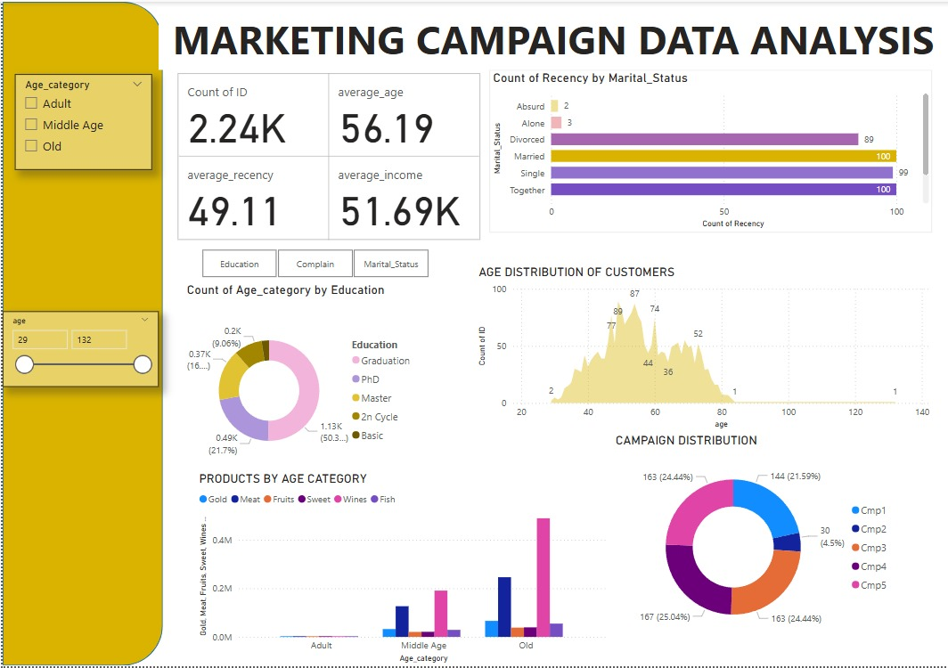
RESULTS

Slide 8
Data Insights and Suggestions
The total number of the customer base that the company possesses is 2.24K.
The average age of customers is 56.19 years meaning the campaign strategies must be targeted to that age group.
The average recency of customer is 49.11 which gives us an estimate of the recurring customer activity, this parameter is what the company aims to improve via their campaigns.
Majority of customer do not have teenagers at home.
Most old customers are found to buying wine, followed by meat. The same trend is followed by middle aged people.
Most of the customer base is married.
Most of the customer base maximum education is graduation.
So far, the campaign #4 has worked the best in obtaining responses from customers, followed by #3 and #5.

Slide 9
Git-hub Link
https://github.com/soumili-03/VOIS_marathon_Team4_Marketing_Campaign

Slide 10
Thank you
.
.

